Slide 1
SOEN 384
Management, Measurement and Quality Control http://users.encs.concordia.ca/~s384_2/
Instructor: Dr. Olga Ormandjieva
Lecture 2:
Classical measurements. Software measurement tools.

Slide 2
Agenda for today
Review
  Software project management v.s. Manufacturing project management
  Course assumptions
SWEBOK
Software Measurement – basic notions
Classical measures (LOC, McCabe cyclomatic complexity, McCabe essential complexity)
Next?
SOEN384-F15-L2: Classical measures - McCabe

Slide 3


What is a Software-based Development Project?
A set of activities performed by people with assistance from a variety of tools, computers, compilers, software development environments, test equipment, etc.
a set of processes that connect those activities in order in which the activities must be accomplished
Constraints: scope, schedule, budget, quality
Specific characteristics:
  It is extremely difficult to look at a piece of software and to know the status of the work involved in developing it.
  Creates a unique product or service
  Different team dynamics
  …
SOEN384-F15-L2: Classical measures - McCabe

Slide 4
What software development project managers typically do?
Understand the business needs
Understand the constraints (budget, schedule, scope, volatility of requirements ... )
Negotiate a commitment (scope, schedule, budget, resources)
Lead in planning
  Identify every activity, define the activities, allocate resources to activities, schedule activities, and assign responsibility for completion of activities for the overall project.
  Clearly define and manage the definition of interfaces (technical and interpersonal communication)
Communicate goals, plans, project status, and changes to all of the stakeholders.
Execute the plan by monitoring the status and identifying discrepancies between the plan and the status, and addressing issues

Slide 5
Some course assumptions
(the material has to be tailored to other environments)
Life cycle models and development processes
  Waterfall
  Spiral
  Agile
Team size 10-20 people in average
New development
SOEN384-F15-L2: Classical measures - McCabe

Slide 6
Software Engineering Management Subareas (SWEBOK)
Software project management process (5 subareas)
  Management process refers to the activities that are undertaken in order to ensure that the software engineering processes are performed in a manner consistent with the organization’s policies, goals, and standards.
Software engineering measurement (1 subarea)
  Measurement refers to the assignment of values and labels to aspects of software engineering (products, processes, and resources ) and the models that are derived from them, whether these models are developed using statistical or other techniques.
SOEN384-F15-L2: Classical measures - McCabe

Slide 7
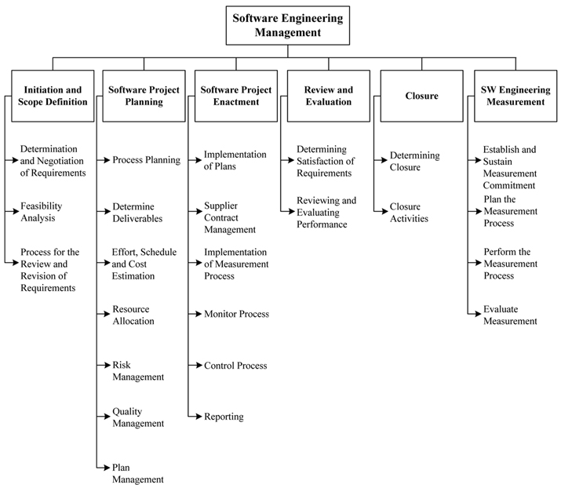
BREAKDOWN OF TOPICS FOR SOFTWARE ENGINEERING MANAGEMENT: SWEBOK
SOEN384-F15-L2: Classical measures - McCabe
Notes:
Primary basis for the top-level breakdown is the process of managing a software engineering project.

Slide 8
Software Engineering Management Subareas (SWEBOK)
Software project management process (5 subareas)
Software engineering measurement (1 subarea)
Why two different subjects (management and measurement) are combined?
  Management without measurement, qualitative and quantitative, suggests a lack of rigor
  measurement without management suggests a lack of purpose or context.
SOEN384-F15-L2: Classical measures - McCabe

Slide 9
Course Topics by Areas
Part I: Software Measurement
Part II: Software Project Management
Part III: Agile Estimating and Planning.
SOEN384-F15-L2: Classical measures - McCabe

Slide 10
What is Measurement?
Measurement is the process by which numbers or symbols are assigned to things in the real world in such a way as to characterize (interpret) them according to clearly defined rules.
SOEN384-F15-L2: Classical measures - McCabe

Slide 11


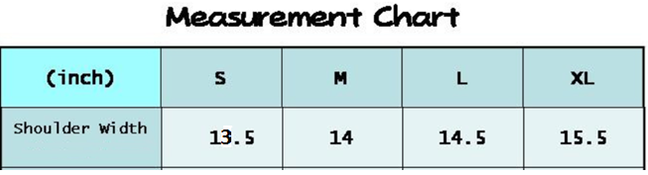
Everyday life example:
Yoke measure
Measurement
Measurement Rule: measure shoulders straight across from left shoulder seam to right shoulder seam.
Shoulder width
in inches
Interpretation of the result:
SOEN384-F15-L2: Classical measures - McCabe

Slide 12
Software measurement?
RE: H1 on SLOC
Measurement of SLOC (Homework 1) Rules? Tools?
Number of Source Lines of Code
Code
Interpretation of the result:
Acceptable?
Needs a review?
Unacceptable?
(Homework 2)
Measurement Feedback
SOEN384-F15-L2: Classical measures - McCabe

Slide 13
Why measurement?
Project Cost-Benefits Analysis
and Planning
Requirements Capture
Analysis & Design
Implementation
Test
Measurement Feedback
Prepare Release
Customer satisfaction
SOEN384-F15-L2: Classical measures - McCabe
Notes:
Feedback’s intrinsic flaw isn’t in the medium or the message — it’s in the metrology. Feedback must be explicitly linked to metrics, measures, and mechanisms that track the desired — and desirable — change. Feedback that comes without ways to monitor measurable change is less meaningful feedback than it is well-intentioned advice. In other words, effective feedback requires effective feedback.
More precisely, measurement goal is to identify anomalies within the same development phase in which it originated, as well as to measure progress

Slide 14
Agenda
More classical measurement: McCabe measures
  Cyclomatic complexity
  Essential complexity
SOEN384-F15-L2: Classical measures - McCabe

Slide 15
McCabe Cyclomatic Complexity: monitors logic based code coverage (Linearly Independent Path Coverage) and produces untested test conditions so that test effectiveness can be incrementally increased.
McCabe cyclomatic complexity (McCabe IQ tool)
Code’s
Control-Flow Graph
Number of linearly dependent paths in the code to test
Interpretation of the result:
Acceptable?
Needs a review?
Unacceptable?
(Assignment 1 – part 1)
Measurement Feedback used to illuminate hidden software risks in code (testing and maintenance rework will be costly)
SOEN384-F15-L2: Classical measures - McCabe

Slide 16
Control-Flow Graph (Flowgraph)
Procedure node
(out-degree=1)
Start node
(in-degree=0)
Quadruple (E, N, s, t)
  N : set of nodes
  s: Start node
  t: Terminal node
  E : set of edges
In-degree (FAN-IN): number of edges arriving at node
Out-degree (FAN-OUT): number of edges leaving the node
Path: sequence of consecutive edges
s
Decision node
(out-degree>1)
Terminal node
(out-degree=0)
t
SOEN384-F15-L2: Classical measures - McCabe

Slide 17
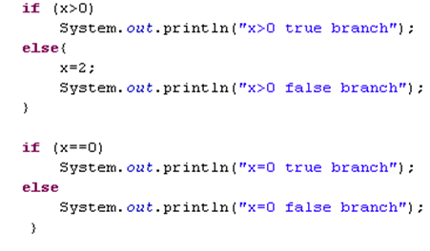
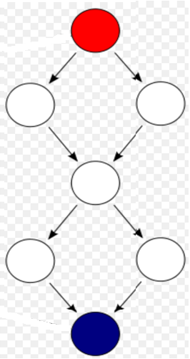
Example
SOEN384-F15-L2: Classical measures - McCabe

Slide 18
McCabe’s Cyclomatic Complexity
If G is the control flowgraph of program P
and G has e edges and n nodes
v(P) = e – n + 2
v(P) is the number of linearly independent
paths in G
here, e = 16, n=13, and v(P) = 5
More simply, if d is the number of decision
nodes in G then
v(P) = d + 1
SOEN384-F15-L2: Classical measures - McCabe

Slide 19
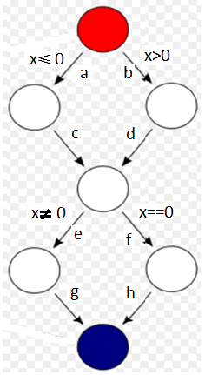
Example:
Cyclomatic Complexity = ?
Linearly Independent Paths?
SOEN384-F15-L2: Classical measures - McCabe

Slide 20
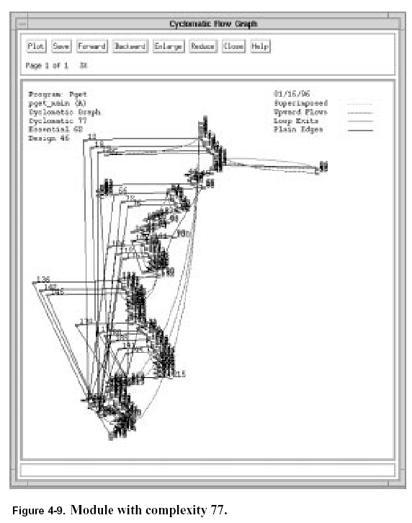
Order: P2 “is more complex than” P1
SOEN384-F15-L2: Classical measures - McCabe

Slide 21
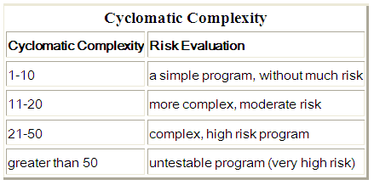
McCabe cyclomatic complexity (revisited)
McCabe cyclomatic complexity (McCabe IQ tool)
Code’s
Control-Flow Graph
Number of linearly dependent paths in the code to test
Interpretation?
Acceptable?
Needs a review?
Unacceptable?
SOEN384-F15-L2: Classical measures - McCabe

Slide 22
Agenda
More classical measurement: McCabe measures
  Cyclomatic complexity
  Essential complexity
SOEN384-F15-L2: Classical measures - McCabe

Slide 23
Control-Flow Graph (CFG)
Structure
Bohm and Jacobini, 1966:
every algorithm may be implemented using just the structured programming constructs sequence, selection, iteration.
SOEN384-F15-L2: Classical measures - McCabe

Slide 24
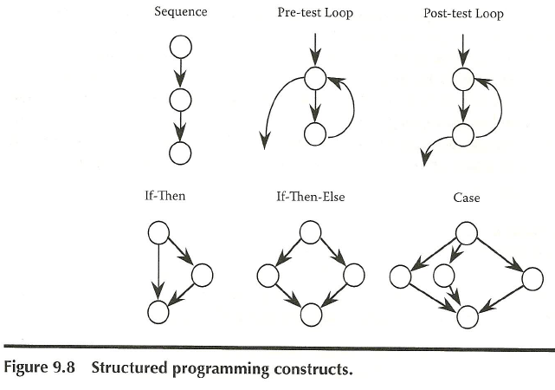
SOEN384-F15-L2: Classical measures - McCabe

Slide 25

Unstructured Constructs
Branching out of a loop
Branching in to a loop
Branching into a decision
Branching out of a decision
SOEN384-F15-L2: Classical measures - McCabe

Slide 26
McCabe essential complexity
BEST value: EV(G) = 1
<Completely structured>
Measures how much unstructured logic exists in a module
The essential complexity can be computed on a graph in which structured constructs are collapsed to a single node, until no more structured constructs can be found
Example (next)
SOEN384-F15-L2: Classical measures - McCabe

Slide 27
Calculating Essential Complexity: Flow Graph Reduction
Original Graph
Reduced Graph
Remove structured code constructs, then calculate the Cyclomatic Complexity of reduced graph
SOEN384-F15-L2: Classical measures - McCabe

Slide 28
Calculating Essential Complexity: Flow Graph Reduction
Original Graph
Reduced Graph
BEST value: EV(G) = 1
<Completely structured>
Cyclomatic
Complexity = 4
Essential
Complexity = 1
McCabe’s Essential Complexity EV(G)
Remove structured code constructs, then calculate the Cyclomatic Complexity of reduced graph
SOEN384-F15-L2: Classical measures - McCabe

Slide 29
Essential Complexity, EV(G)
Definition: Essential Complexity, ev, is a measure of the degree to which a module, G, contains unstructured constructs.
Calculation: ev(G) is equal to the Cyclomatic Complexity of a reduced flowgraph, v(G’), where reduction is completed by removing all structured constructs. The remaining flowgraph is a view of the impact of unstructured code.
Advantages
  Quantifies the degree of structuredness
  Reveals the quality of the code
  Predicts the maintenance effort
  Helps the modularization process
SOEN384-F15-L2: Classical measures - McCabe

Slide 30
Another Example
first
first
a
a
d
A
b
A
b
B
C
E
H
c
D
F
G
L
c
L
H
I
last
J
K
last
e
first
a
first
L
d
e
last

Slide 31
More examples
V(G) = 20
V(G) = 18
Function A
Function B
EV(G) = 1
EV(G) = 17
(Reduced graphs superimposed on original graphs)
SOEN384-F15-L2: Classical measures - McCabe
5.17s

Slide 32
Questions?
…
SOEN384-F15-L2: Classical measures - McCabe

Slide 33
Next?
Collecting and Analyzing Software Measurement Data. Simple analysis techniques.
SOEN384-F15-L2: Classical measures - McCabe

